Slide 1
Module: Memory Errors
Stack Canaries
Yan Shoshitaishvili
Arizona State University

Slide 2
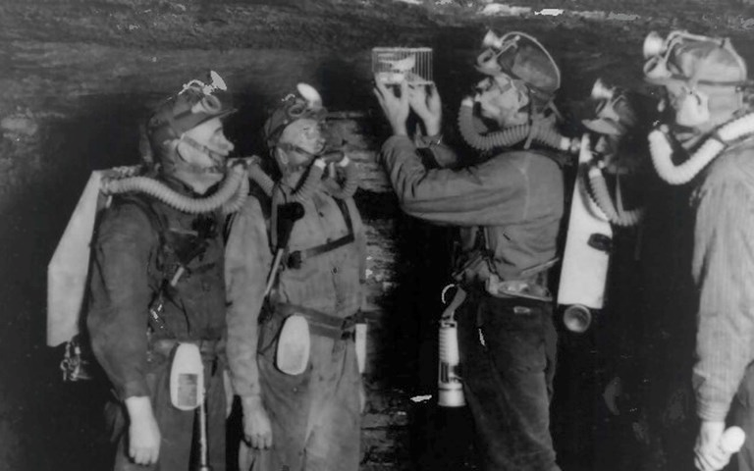

Slide 3

Crispin Cowan, Calton Pu, Dave Maier, Heather Hinton, Jonathan Walpole,
Peat Bakke, Steve Beattie, Aaron Grier, Perry Wagle and Qian Zhang.
Oregon Graduate Institute of Science & Technology.
"StackGuard: Automatic Adaptive Detection and Prevention of Buffer-Overflow Attacks."
USENIX Security Symposium, 1998.

Slide 4
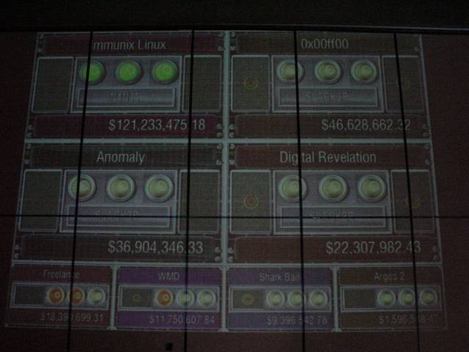


Slide 5
Stack Canaries
To fight buffer overflows into the return address, researchers introduced stack canaries.
In function prologue, write random value at the end of the stack frame.
In function epilogue, make sure this value is still intact.
Easier to show than tell!

Slide 6
Stack Canaries
Stack canaries are VERY effective in general.
Situational bypass methods:
Leak the canary (using another vulnerability).
Brute-force the canary (for forking processes). int main() { char buf[16]; while (1) { if (fork()) { wait(0); } else { read(0, buf, 128); return; } } }
Jumping the canary (if the situation allows). int main() { char buf[16]; int i; for (i = 0; i < 128; i++) read(0, buf+i, 1); } Depending on the stack layout, you can overwrite i and redirect the read to point to after the canary!

